Slide 1

Sarcasm Detection and Rewriting
Team 38 - The SUS
Umang Patel (2022101037)
Sparsh Goel (2022101051)
Sahil Patel (2022101046)

Slide 2
Introduction
Problem: Sarcasm is prevalent on social media but misleads sentiment analysis algorithms
Challenge: Sarcasm involves a complex structure of:
Contextual semantics
Syntactic patterns
Affective markers
Implicit contradictions
Impact: Inaccurate sentiment analysis leads to:
Misleading insights from user feedback
Incorrect interpretation of customer reviews
Flawed brand sentiment measurement
Our solution: A two-stage system that detects sarcasm and transforms it into literal language

Slide 3
Why Is Sarcasm Detection Difficult?
Inherent irony and contradiction
Relies on cultural context and shared knowledge
Often combines positive words with negative intent
Requires understanding beyond surface-level semantics
Examples:
"Congratulations on stating the obvious." → Appears positive but conveys criticism
"Sure, let's ignore all evidence." → Seemingly agreeable but implies disagreement
"I'm sure glaciers will start moving any minute now." → Expresses disbelief through feigned certainty

Slide 4
Project Objectives
Primary Goal: Develop an end-to-end system for sarcasm detection and rewriting
Specific Objectives:
Design an architecture for sarcasm detection
Create a robust feature representation that captures semantic, syntactic, and affective aspects
Develop a rewriting model that preserves content while removing sarcastic tone
Analyze model behavior through visualizations of internal mechanisms

Slide 5
Literature Review: Sarcasm Detection
Mohan et al. (2023) - "Sarcasm Detection Using BERT and GCN"
Combined transformer and GCN approaches
Created separate dependency and affective graphs
Used alternating graph processing
Achieved 90.7% accuracy on the Headlines dataset
Yaghoobian et al. (2021) – “Sarcasm Detection: A Comparative Study”
Compared various ML and DL techniques
Highlighted the importance of context features
Showed limitations of pure lexical approaches
Šandor and Bagic Babac (2023) – “Sarcasm Detection in Online Comments Using Machine Learning”
Focused on online user comments
Explored feature importance in the social media context

Slide 6
Literature Review: Text Attribute Transfer
Li et al. (2018) - "Delete, Retrieve, Generate"
Identified attribute markers through frequency analysis
Proposed three-step framework:
Delete attribute markers from source text
Retrieve similar content with the target attribute
Generate new text combining content and target style
Demonstrated effectiveness on sentiment transfer tasks
Our Approach: We ultimately opted for a GAN-based architecture for the rewriting component, the delete-retrieve-generate paper influenced our decision to use the GAN-based network as simple delete-retrieve-generate won’t be able to capture the contextual relationships

Slide 7
Datasets
Combined multiple datasets for comprehensive training:
Sarcasm on Reddit:
1.3 million comments (self-annotated)
Diverse range of topics and contexts
Contains natural sarcasm expressions
Mustard Dataset:
Sarcastic comments from popular TV shows (Friends, Golden Girls, Big Bang Theory)
Includes multimodal information
Professional dialogue with deliberate sarcasm
iSarcasm Dataset:
4,484 tweets with 777 labeled as sarcastic
Used specifically for training the rewriting module
Contains human-written non-sarcastic counterparts for evaluation

Slide 8
Data Preprocessing & Feature Engineering
Preprocessing Pipeline:
Tokenization using NLTK and spaCy
Lowercasing and punctuation normalization
Lemmatization for word normalization
Context extraction for relevant samples
Feature Extraction:
Semantic Features:
300-dimensional GloVe embeddings (glove-wiki-gigaword-300)
Captures distributed word semantics
Affective Features:
5-dimensional sentiment vector from SenticNet
Components:
Polarity value (-1 to 1)
Positive sentiment flag
Negative sentiment flag
Neutral sentiment flag
Intensity value

Slide 9
Graph Construction: Technical Details
Node Creation:
Words extracted using the spaCy dependency parser
Each node represents a token in the text
Node features: [GloVe embedding (300D) || SenticNet vector (5D)]
Edge Formation:
Window-based Edges:
Connect adjacent words within a window size of 2
Capture local context and n-gram relationships
Help the model learn phrase-level patterns
Dependency-based Edges:
Derived from a syntactic dependency parse
Represent grammatical relationships
Enable long-distance connections between related words
Implementation: PyTorch Geometric framework with NetworkX for initial graph creation

Slide 10
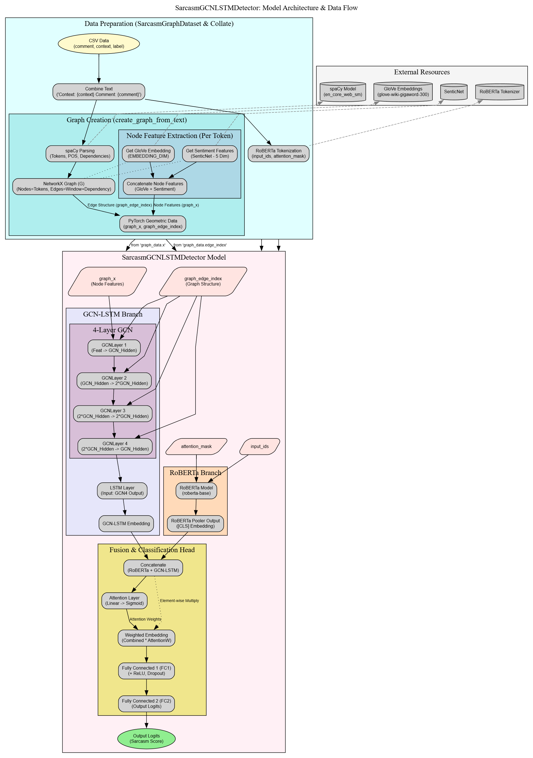
Detection Model Architecture: Overview

Slide 11
Detection Model Architecture: Overview
Hybrid Architecture Components:
Text Encoder: RoBERTa extracts contextual embeddings
Graph Processing: 4-layer GCN with sequential modeling
Feature Fusion: The Attention mechanism combines representations
Classification: Fully connected layers for final prediction
Innovation: Integrates transformer-based language understanding with graph-based structural and sentiment analysis

Slide 12
Detection Model: RoBERTa Component
Transformer-based Text Encoding:
Base Model: RoBERTa-base (125M parameters)
Input Processing:
Special tokenization with BPE
Max sequence length: 128 tokens
Attention masking for variable-length inputs
Output: 768-dimensional pooled embedding from [CLS] token
Training: Fine-tuned with adapter layers to prevent catastrophic forgetting
Purpose: Capture deep contextual relationships and semantic understanding of text, particularly implicit meaning in sarcastic expressions

Slide 13
Detection Model: Graph Convolutional Network
4-layer GCN Implementation:
Layer 1: Input dim (305) → Hidden dim (64)
Layer 2: Hidden dim (64) → Hidden dim (128)
Layer 3: Hidden dim (128) → Hidden dim (128)
Layer 4: Hidden dim (128) → Hidden dim (64)
Technical Details:
GCNConv layers from PyTorch Geometric
BatchNorm1d after each convolution
ReLU activation and dropout (0.2)
Processes the integrated graph with dual edge types
Gradually increases and then decreases feature dimensions for the bottleneck effect
Purpose: Learn structural patterns in text that indicate sarcasm, particularly syntactic contradictions and sentiment incongruities

Slide 14
Detection Model: Sequential Processing & Fusion
Sequential Processing:
LSTM processes the GCN output sequence
Bidirectional with hidden dim 32 (64 total)
Captures sequential dependencies in node features
For batch processing: mean aggregation strategy
Attention-based Fusion:
Combines RoBERTa embedding with GCN-LSTM output
Attention mechanism: Linear(hidden_dim + gcn_dim, 1)
Dynamic weighting based on feature importance
Allows the model to focus on different aspects per sample
Final Classification:
FC layer: (hidden_dim + gcn_dim) → 256
ReLU activation + dropout
Output layer: 256 → 1 (binary classification)
Sigmoid activation for probability output

Slide 15
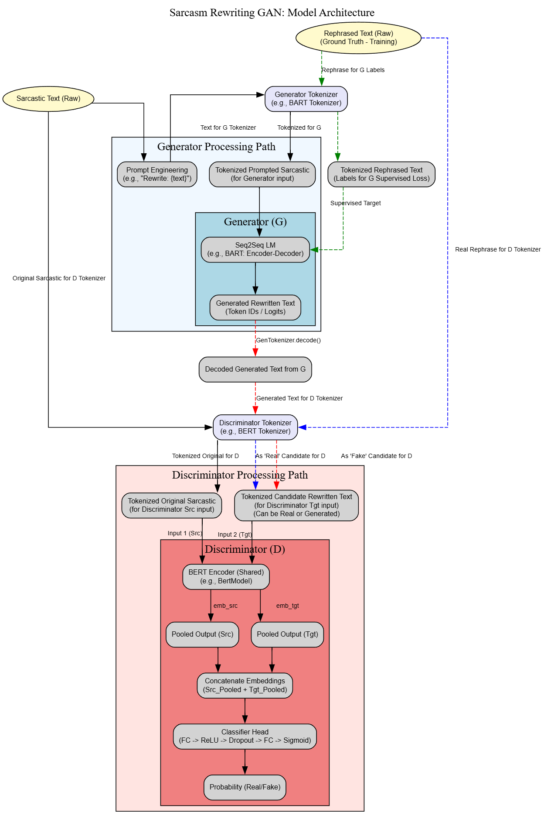
Rewriting Module: GAN Architecture

Slide 16
Rewriting Module: GAN Architecture
Generator: BART encoder-decoder model for text transformation
Discriminator: BERT-based classifier for authenticity evaluation
Training Objective: Combined supervised and adversarial losses
Inference Process: Beam search with width 10 for diverse outputs

Slide 17
Rewriting Module: Technical Details
Generator Architecture:
Base Model: BART-base with 140M parameters
Encoder: Processes sarcastic input text
Decoder: Generates non-sarcastic equivalent with attention on encoder
Input Engineering: Special prompt prefixing ("Rewrite without sarcasm:")
Discriminator Architecture:
Base Model: BERT-based classifier
Input Structure: [CLS] sarcastic text [SEP] rewritten text [SEP]
Output: Probability that transformation is authentic (human-like)
Architecture: Pooled output → FC → Sigmoid
Loss Functions:
Generator Loss: L_G = L_supervised + λ · L_adversarial
L_supervised: Cross-entropy on token prediction
L_adversarial: Binary cross-entropy from discriminator
Discriminator Loss: L_D = 0.5(BCE(D(x,y_real), 1) + BCE(D(x,y_fake), 0))

Slide 18
Performance Metrics: Validation Results
Validation Performance Progression:
Consistent improvement across training epochs
F1-score trajectory aligns with accuracy
Epoch | Accuracy | F1-score
1 | 79.57% | 80.31%
2 | 83.02% | 82.44%
3 | 85.20% | 85.04%
4 | 85.98% | 86.15%

Slide 19
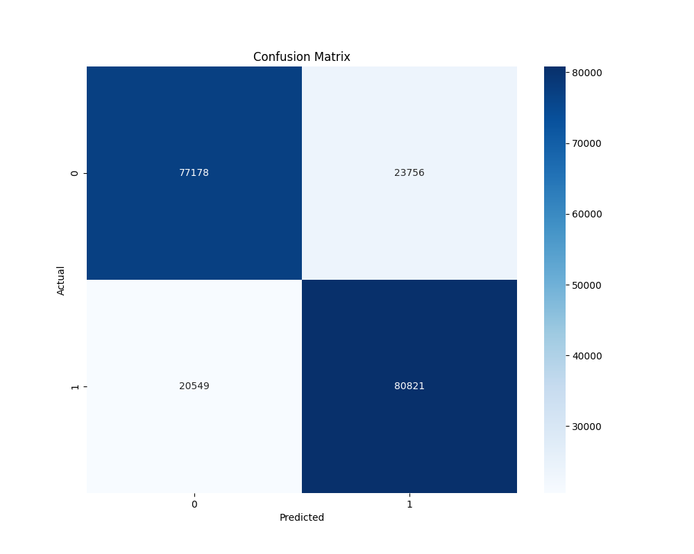
Performance Metrics: Test Results
Final Test Set Performance:
Accuracy: 78.10%
F1-score: 78.49%
Precision: 77.43%
Recall: 79.58%

Slide 20
Sarcasm Rewriting Results: Examples
Sarcastic Input | Non-sarcastic Output
Congratulations on stating the obvious. I'm sure glaciers will start moving any minute now | There is no need to stating the obvious.
Nice of you to show up three minutes late your timing really is something else | It's not nice of you to show up three minutes late.
I don't need your approval, darling, I have my own | I don't need your approval, I have my own opinion.
Sure, let's ignore all evidence and cling to your flawless reasoning | There is no need to ignore all evidence and cling to my flawless reasoning.
Absolutely, let's add that to the dozen other things I definitely wasn't planning to do. | There are a lot of things I don't like doing.
Congratulations on arriving exactly three minutes late Your punctuality is truly inspiring | Having to arrive exactly three minutes late is disappointing but not disappointing.

Slide 21
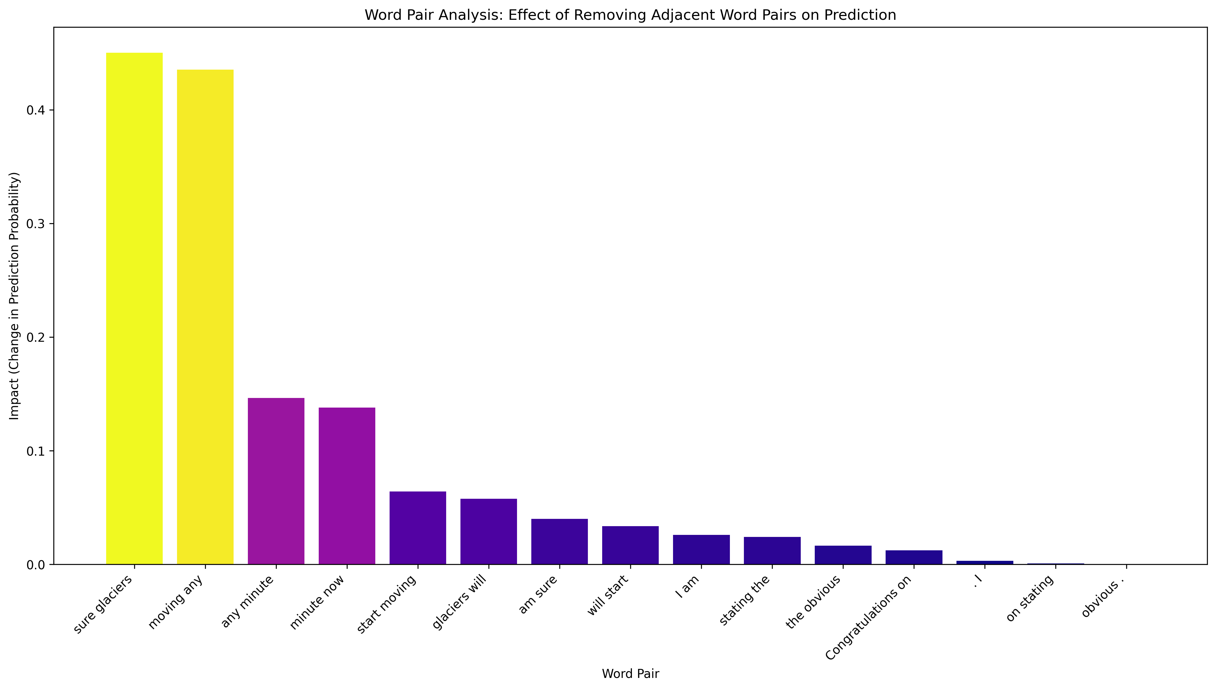

Word-Level Importance Analysis

Slide 22
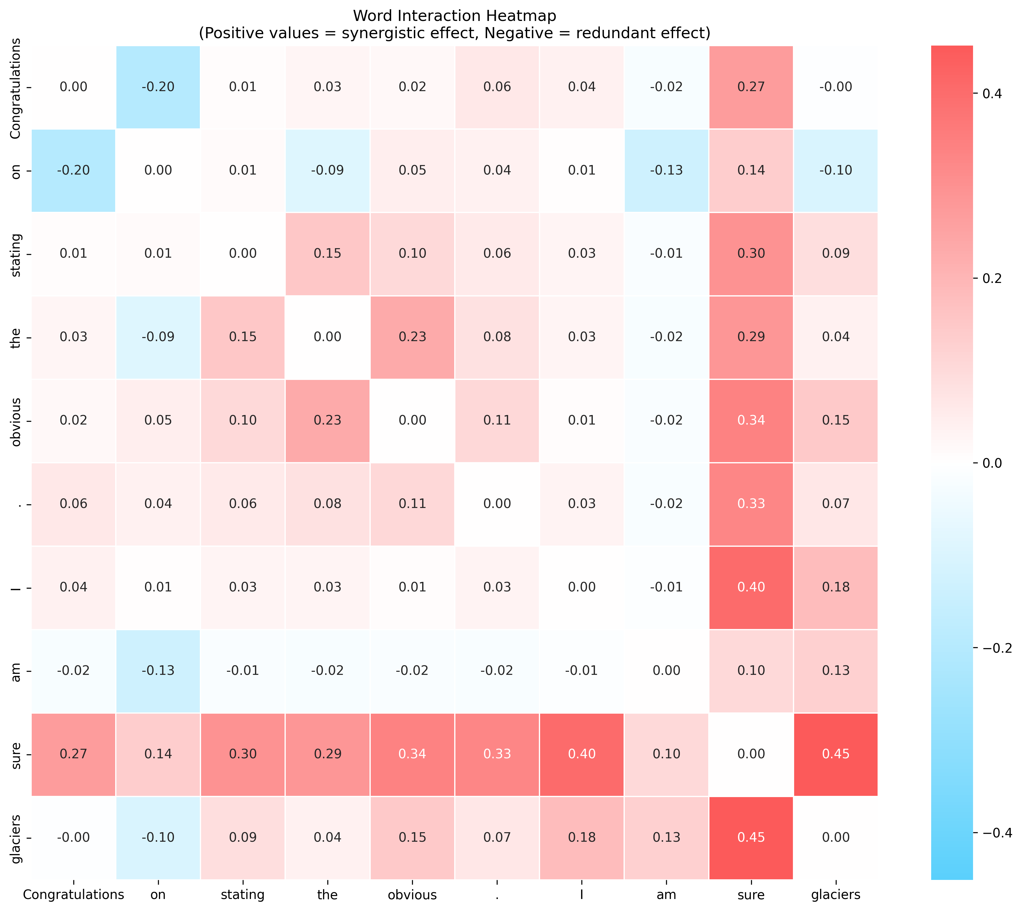
Word-Level Importance Analysis

Slide 23
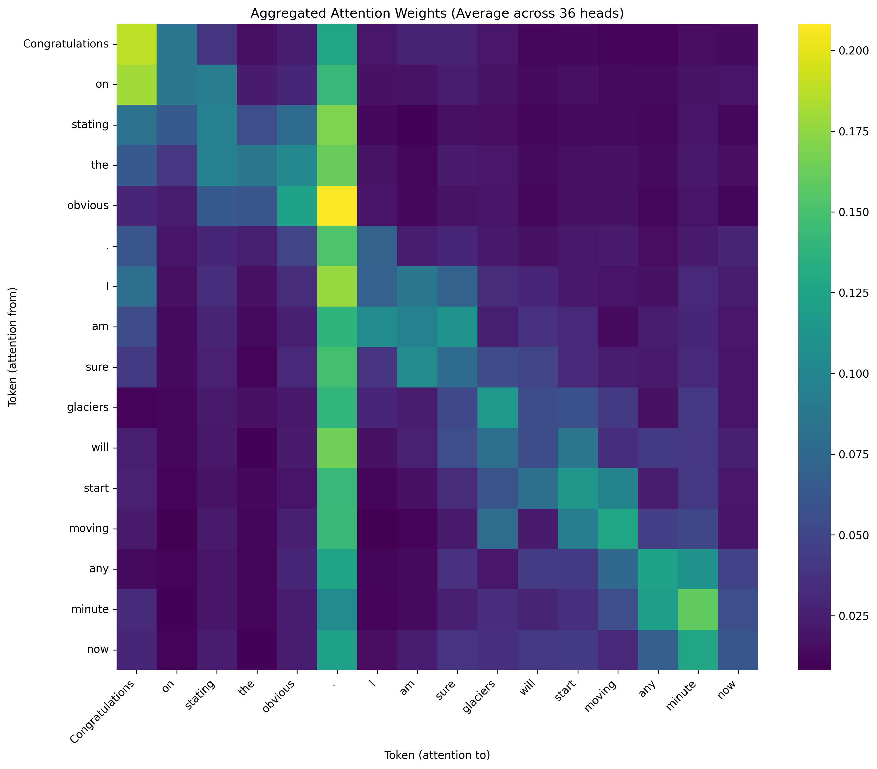
Attention Mechanism Analysis

Slide 24
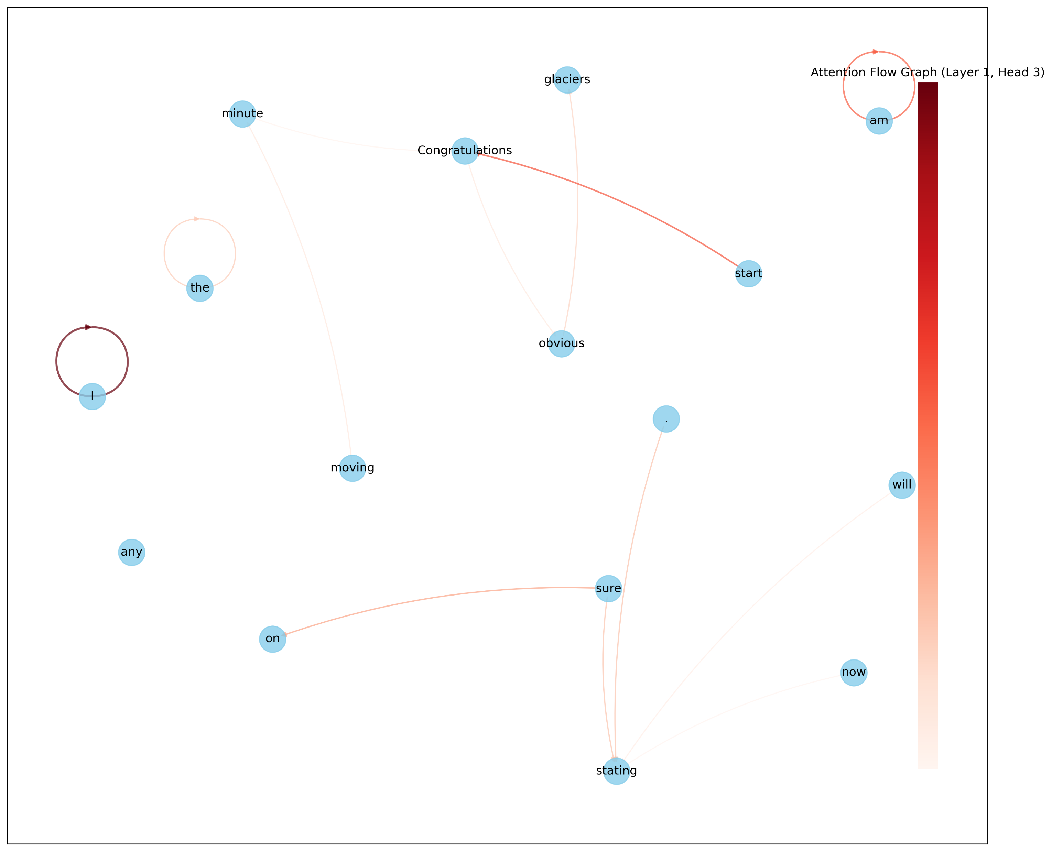
Attention Mechanism Analysis

Slide 25
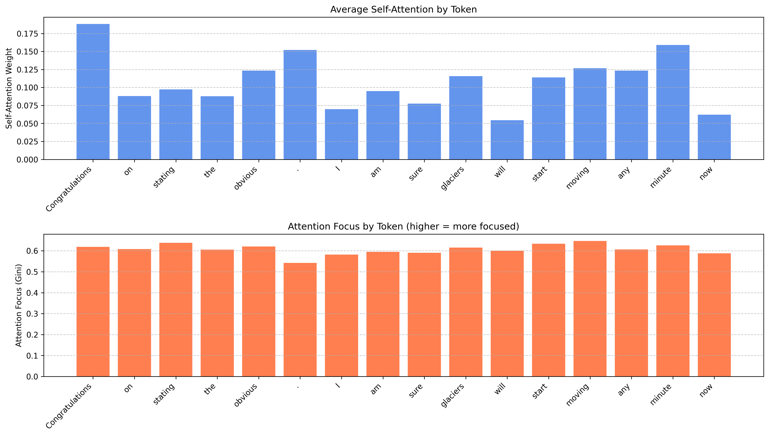
Attention Mechanism Analysis

Slide 26
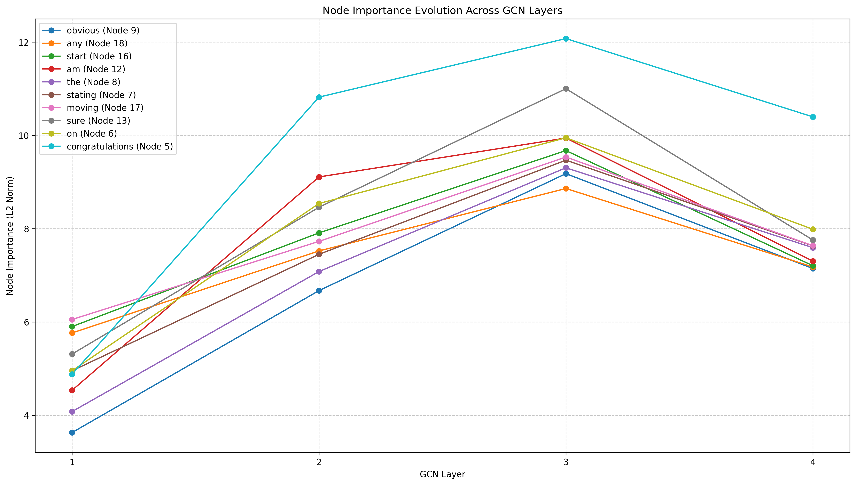
GCN Layer Evolution Analysis

Slide 27
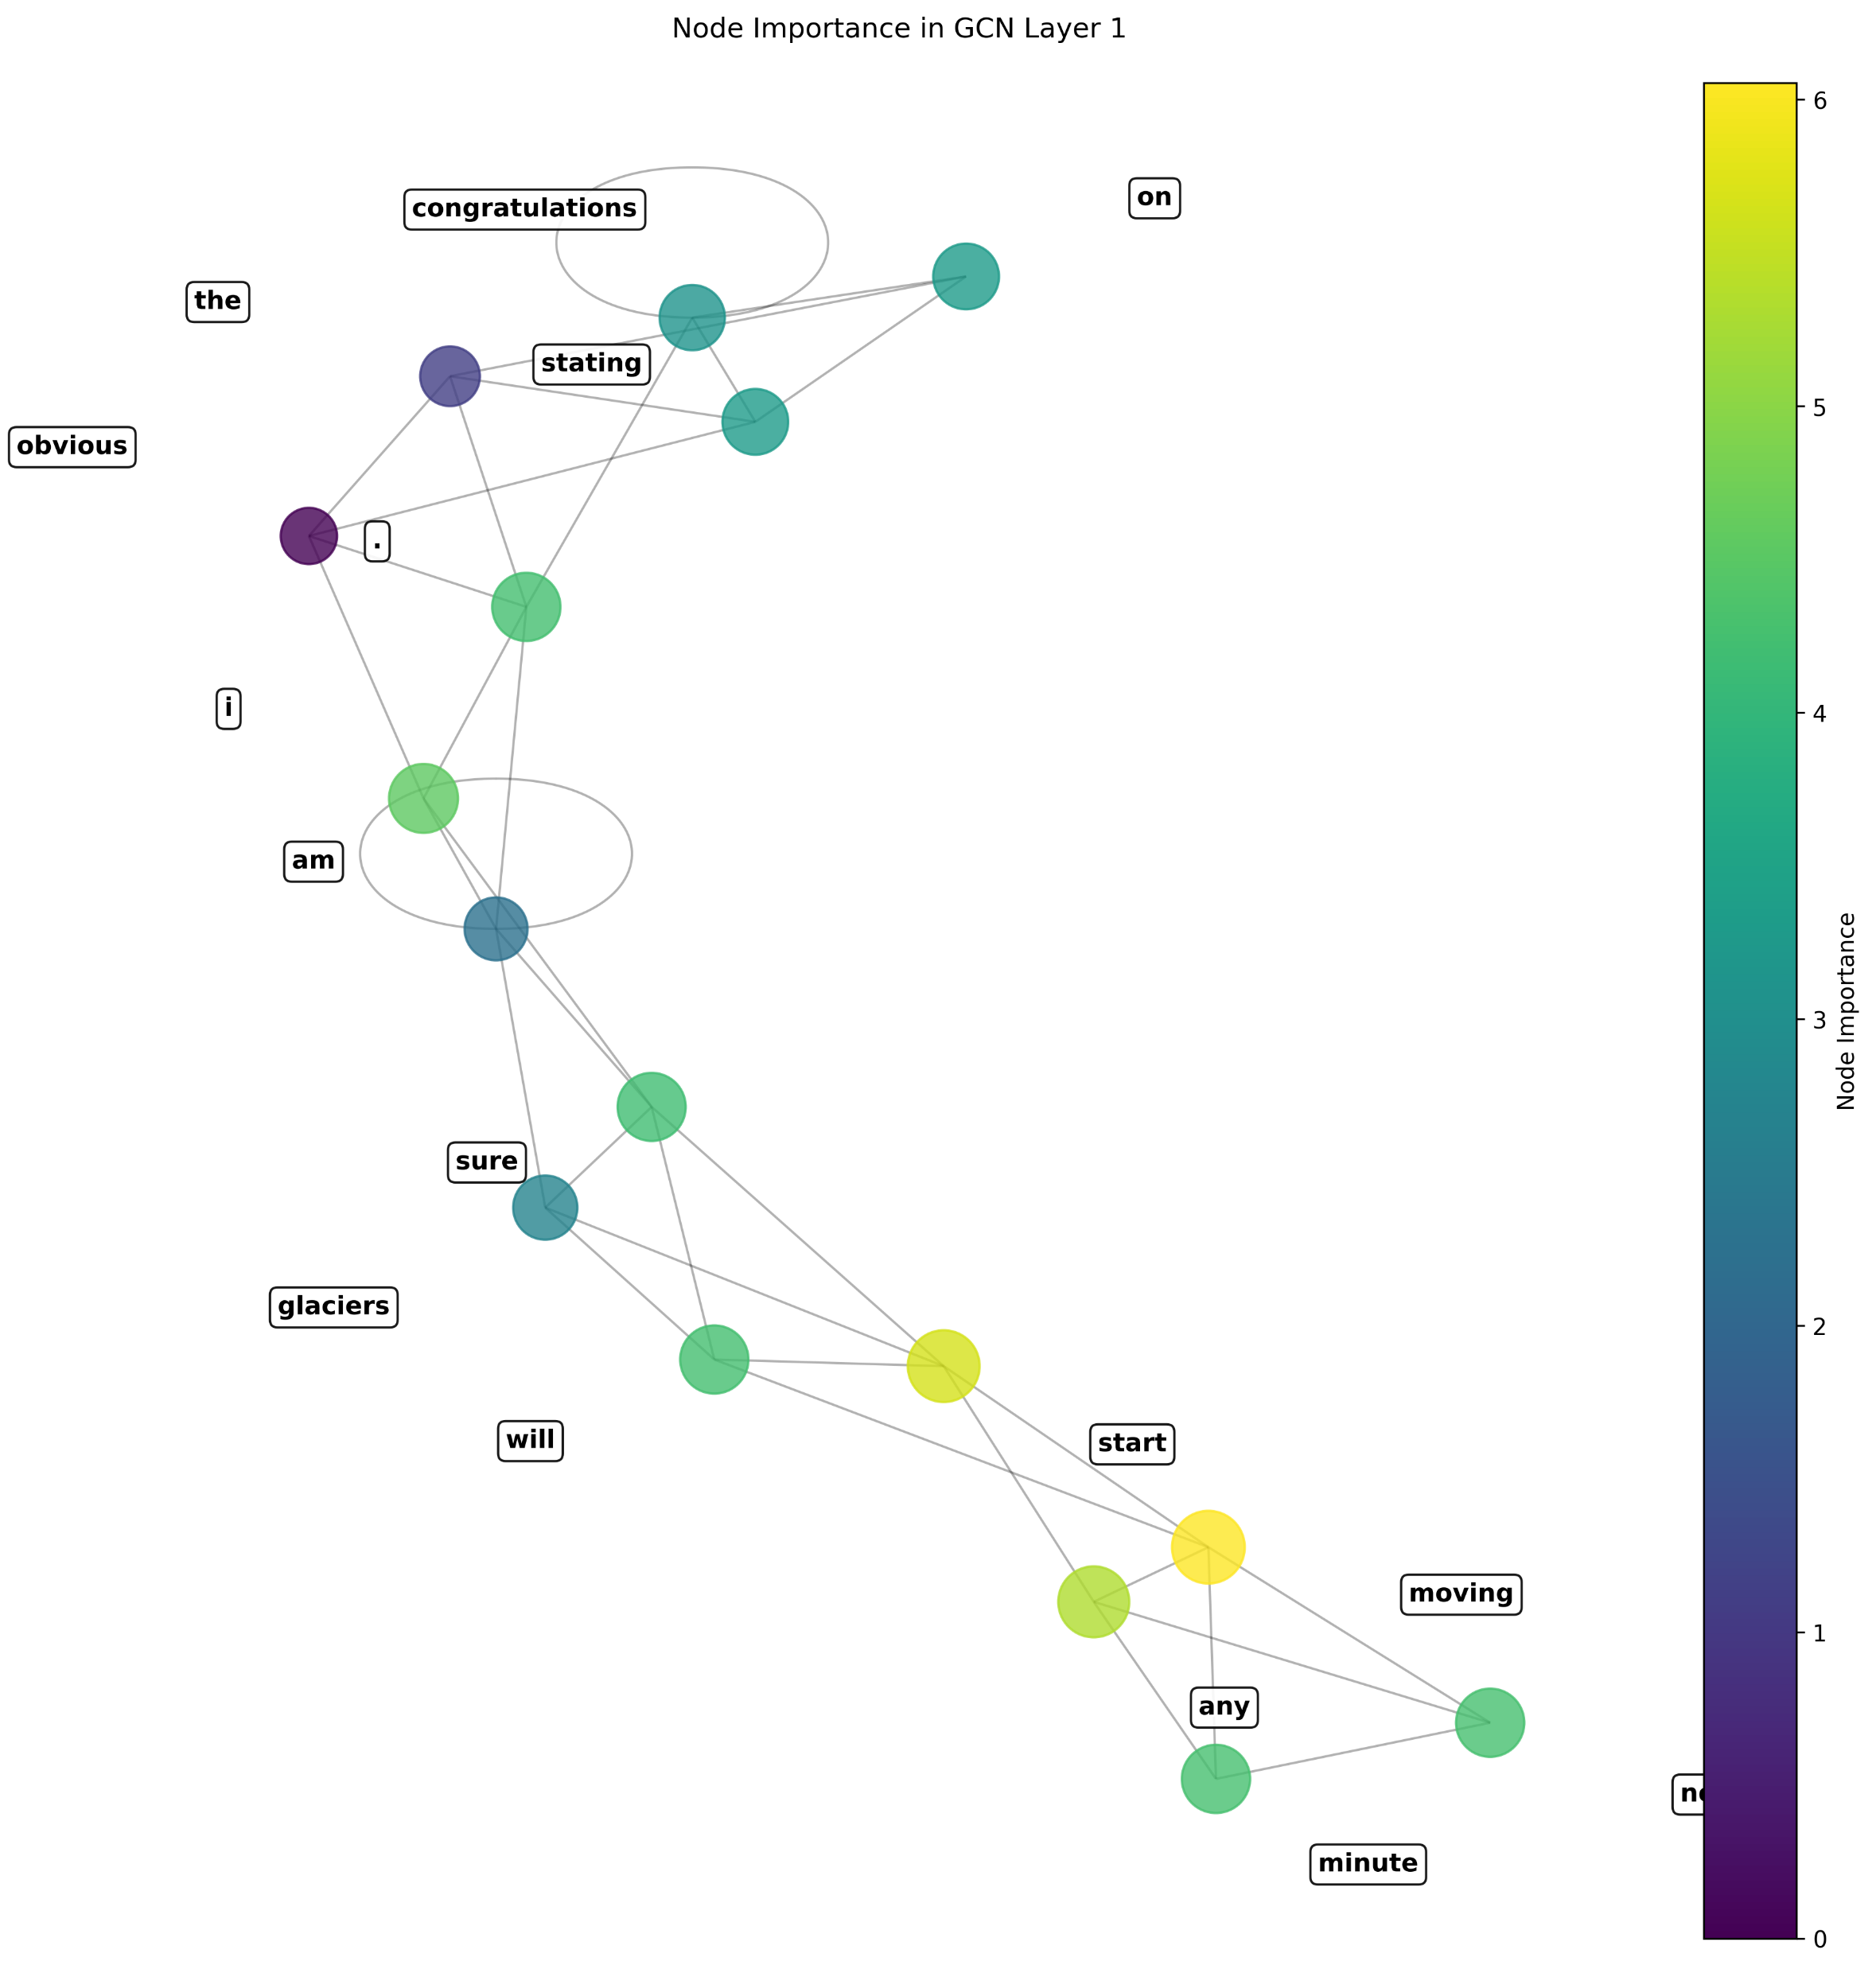
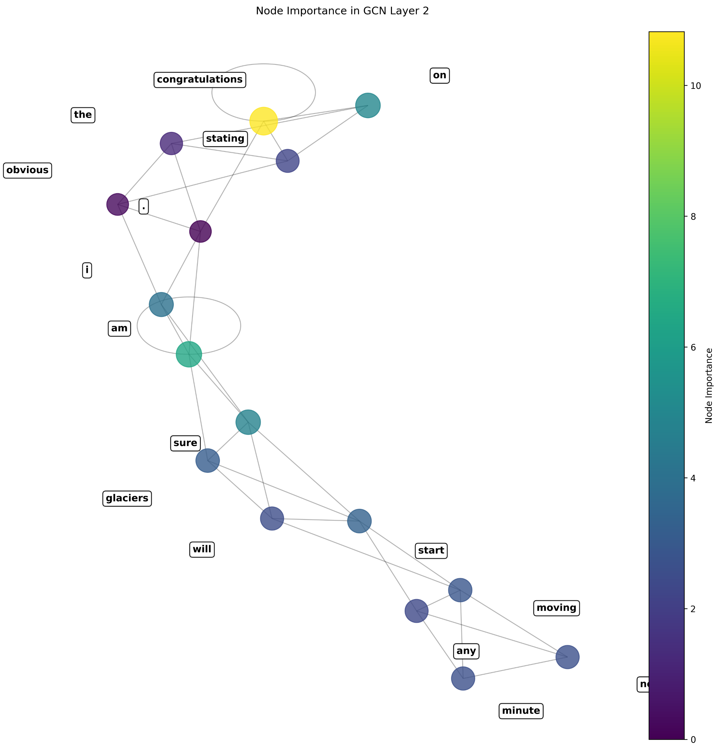
Layer-Specific GCN Analysis

Slide 28
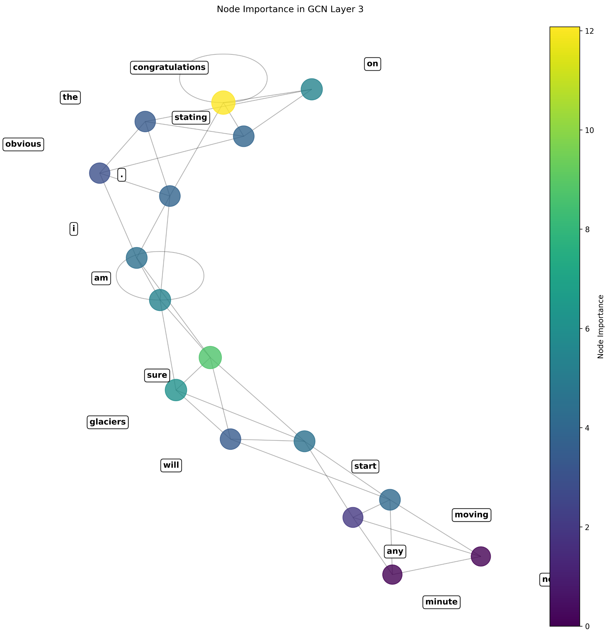
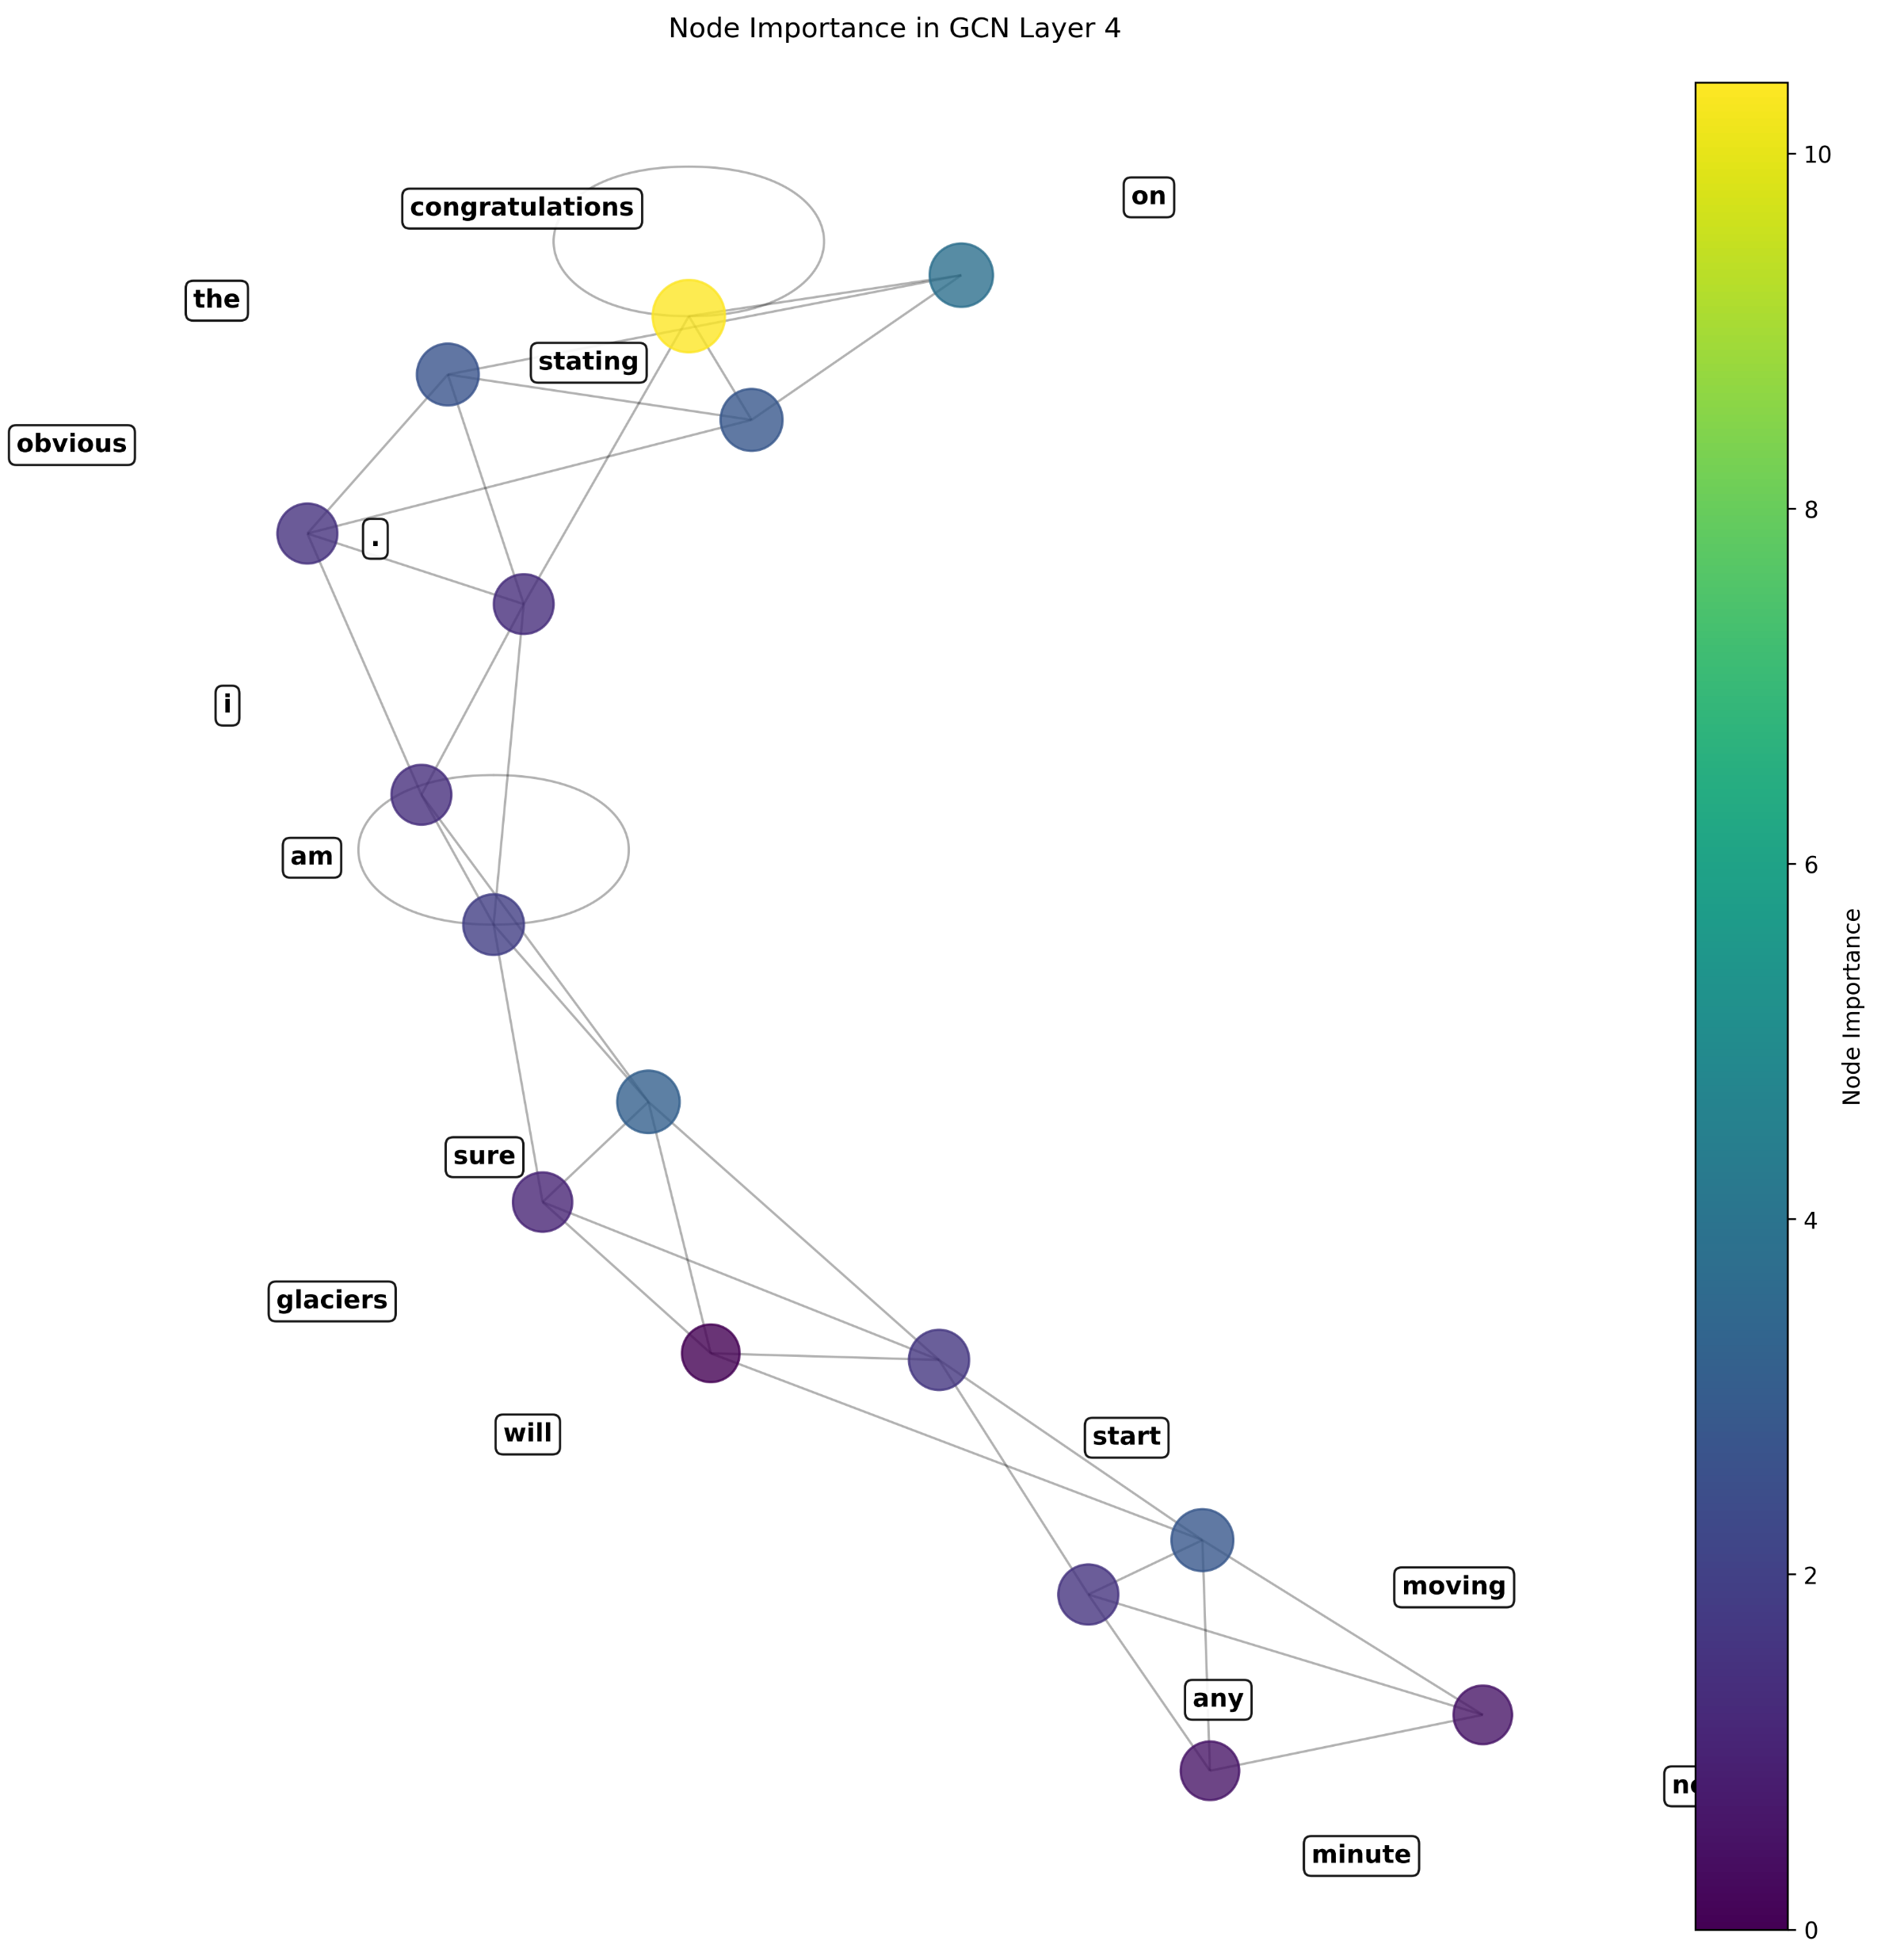
Layer-Specific GCN Analysis

Slide 29
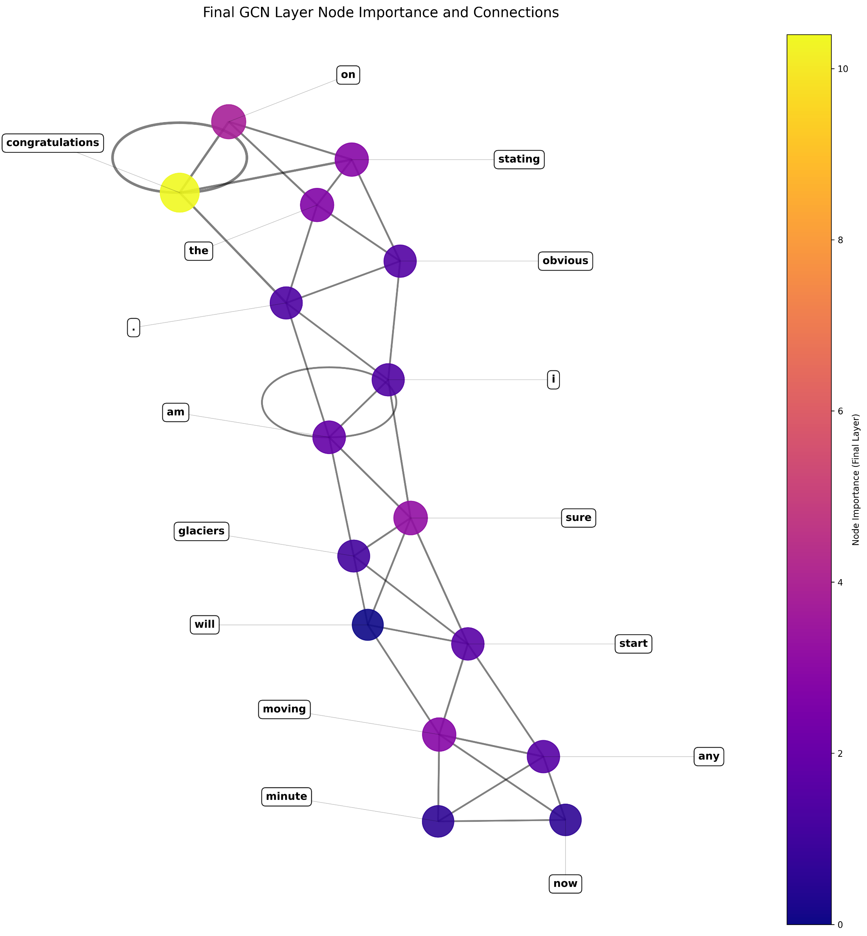
Final Layer GCN Analysis

Slide 30
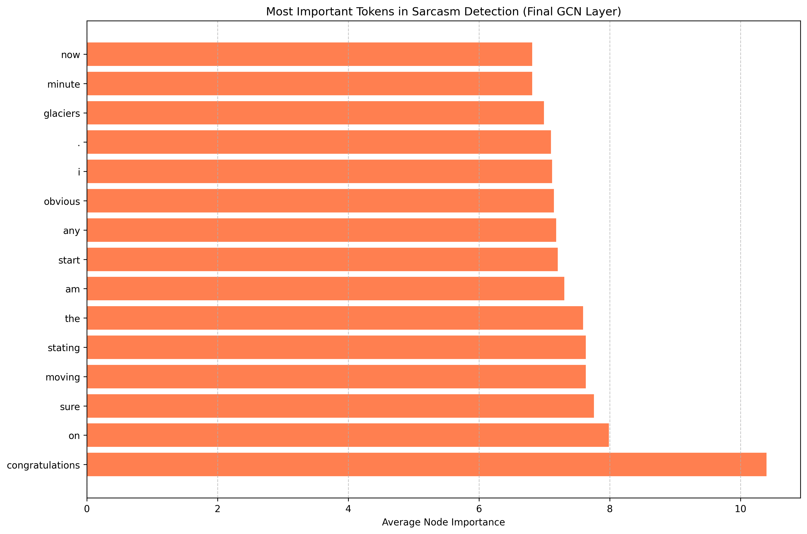
Final Node Importance Analysis

Slide 31
Limitations & Challenges
Detection Challenges:
Cultural and contextual sarcasm requiring world knowledge
Very subtle forms of sarcasm with minimal lexical cues
Domain-specific sarcasm requires specialized training
Rewriting Difficulties:
Preserving exact semantic intent during transformation
Handling multi-sentence sarcastic expressions
Maintaining coherence in complex transformations
Technical Limitations:
Computational demands of graph processing for long texts
Limited by the size of available labeled datasets
Challenge of evaluating rewriting quality objectively

Slide 32
Thank You

